Slide 1
SWOP Taskman Iteratie 2
Jeroen Van Der Donckt
Julien Benaouda
Alexander Braekevelt

Slide 2
DEMO

Slide 3
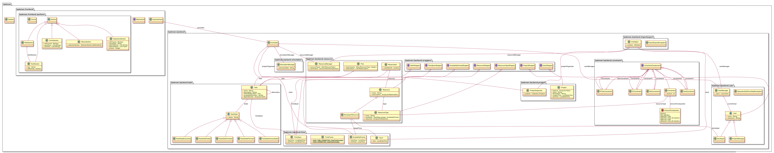
High level design

Slide 4
High level design

Slide 5
High level design

Slide 6
High level design
State pattern (Jeroen)
Composite pattern (Jeroen)
Wrappers (Alexander)
Simulation, user, project & resource manager (Julien)
Controller (Alexander)

Slide 7
Important design decisions: state pattern

Slide 8
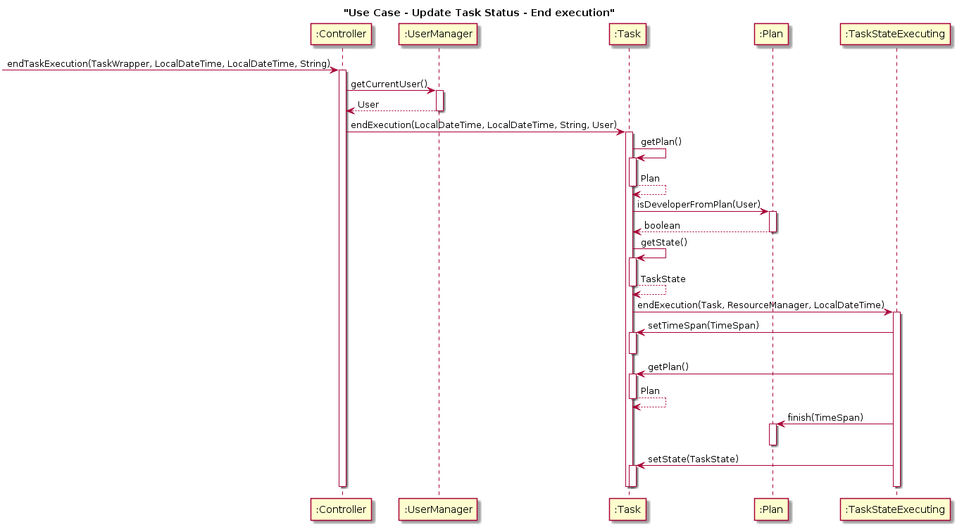
Important design decisions: state pattern

Slide 9
Important design decisions: composite pattern

Slide 10
Important design decisions: wrappers

Slide 11
Important design decisions: managers

Slide 12
Extensibility of the system
resource type constraint in reservation
new task states
new wrappers
decorators of sections

Slide 13
Testing approach
Tests while and after code
Update tests for new implementations
Overall test coverage:
Package | Class, % | Method, % | Line, %
all classes | 96,1% (99/ 103) | 87,9% (593/ 675) | 81,4% (2325/ 2856)

Slide 14
Detailed test coverage
Package | Class, % | Method, % | Line, %
taskman | 0% (0/ 1) | 0% (0/ 2) | 0% (0/ 4)
taskman.backend | 100% (1/ 1) | 74,4% (29/ 39) | 78% (71/ 91)
taskman.backend.constraint | 71,4% (5/ 7) | 64,7% (22/ 34) | 46% (58/ 126)
taskman.backend.importexport | 50% (1/ 2) | 90,9% (10/ 11) | 79,1% (34/ 43)
taskman.backend.project | 100% (2/ 2) | 95,7% (22/ 23) | 88,2% (67/ 76)
taskman.backend.resource | 100% (7/ 7) | 91,4% (74/ 81) | 79,6% (265/ 333)
taskman.backend.simulation | 100% (1/ 1) | 83,3% (5/ 6) | 71,4% (10/ 14)
taskman.backend.task | 100% (7/ 7) | 78,9% (60/ 76) | 84,7% (138/ 163)
taskman.backend.time | 100% (4/ 4) | 84% (21/ 25) | 88,7% (55/ 62)
taskman.backend.user | 100% (5/ 5) | 100% (24/ 24) | 94% (63/ 67)
taskman.frontend | 100% (1/ 1) | 48,1% (13/ 27) | 47,4% (156/ 329)
taskman.frontend.sections | 100% (7/ 7) | 88,6% (31/ 35) | 79,3% (111/ 140)
test.backend | 100% (1/ 1) | 100% (18/ 18) | 95,9% (116/ 121)
test.backend.importExport | 100% (1/ 1) | 100% (5/ 5) | 92,9% (78/ 84)
test.backend.project | 100% (3/ 3) | 100% (21/ 21) | 91,4% (85/ 93)
test.backend.resource | 100% (11/ 11) | 98,5% (65/ 66) | 97,1% (302/ 311)
test.backend.task | 100% (29/ 29) | 94,8% (110/ 116) | 87% (455/ 523)
test.backend.time | 100% (3/ 3) | 100% (22/ 22) | 91,4% (64/ 70)
test.backend.user | 100% (2/ 2) | 100% (11/ 11) | 86,7% (26/ 30)
test.frontend | 100% (8/ 8) | 90,9% (30/ 33) | 97,2% (171/ 176)

Slide 15
Overview of the project management
 | Group work | Individual work | Study
Jeroen | ± 40 hours | ± 45 hours | ± 22 hours
Julien | ± 40 hours | ± 40 hours | ± 25 hours
Alexander | ± 40 hours | ± 48 hours | ± 10 hours

